Slide 1




Postoperative pain
Dealing with publication bias

Slide 2
Contents
01 | Background
02 | Susceptibility to publication bias
03 | Examples with and without susceptibility
04 | How susceptibility works
05 | Calculating susceptibility – method and worked example
06 | Conclusions

Slide 3
Publication bias
There is considerable information on publication bias in Cochrane Handbook
Publication bias refers to negative trials not being published, or where publication is considerably delayed
The implication is that effect sizes in meta-analysis may be inflated because of publication bias
But it is all but impossible to know what the extent of publication is likely to be in almost all circumstances
clinicaltrials.gov and similar registries allow estimates of potential for unpublished material (see CD007400.pub3 for an example of a large amount on known unpublished data)

Slide 4
Susceptibility to publication bias
Possible effects of publication bias in acute pain studies has been examined by estimating the susceptibility of a result to unpublished, null-effect, trials
Done using a threshold for clinical utility of a number needed to treat (NNT), so the method requires dichotomous outcomes
For acute pain, the threshold used is typically set at NNT of 10, as interventions of lesser effectiveness (higher NNT) would probably not be used in acute pain
But the threshold can be set at any level depending on clinical circumstance
Susceptibility is described as number of participants in null effect trials needed to break this clinical utility barrier

Slide 5
Example of susceptibility
The following slide has examples of drugs and doses that were regarded as being susceptible from a Cochrane Overview (CD008659)
The table provides the available data used in a meta-analysis, the numbers of participants in active and placebo arms, the percentages with the outcome, and estimates of relative and absolute effects
The number of participants in null effect trials can then be compared with available data
These were considered susceptible to publication bias as the number of participants in such trials would be found in a small number of trials, often a single trial

Slide 6
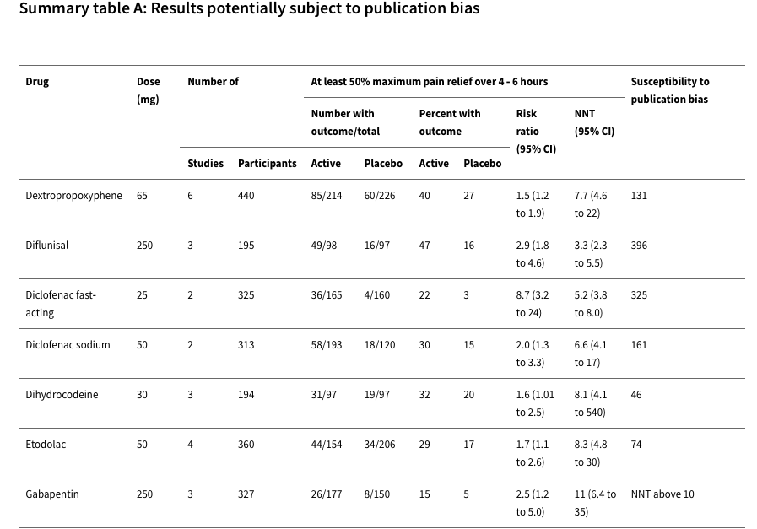

Slide 7
Example without susceptibility
The following slide has examples of drugs and doses from the same Cochrane Overview (CD008659 ) that were not regarded as being susceptible
They were not considered susceptible to publication bias as the number of participants in such trials would be unfeasibly large to exist as unpublished data
In acute pain most comparisons would involve 200 participants or fewer. Taking aspirin as an example from the table, over 30 large unpublished trials with null effect would be required to overturn the result
For more recent drugs, where trials are registered, even 10 hidden trials is unfeasible

Slide 8
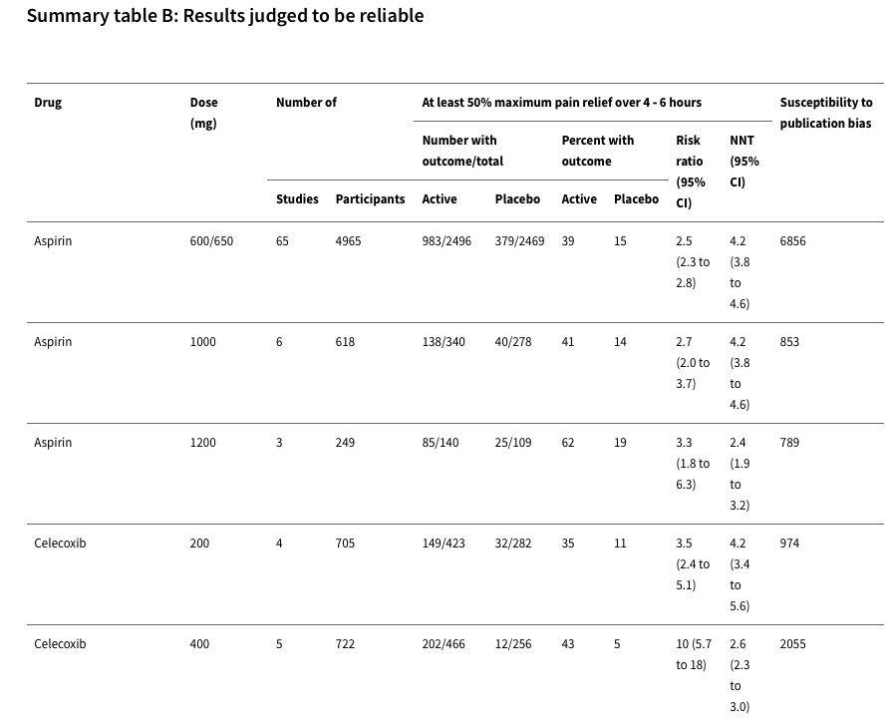

Slide 9
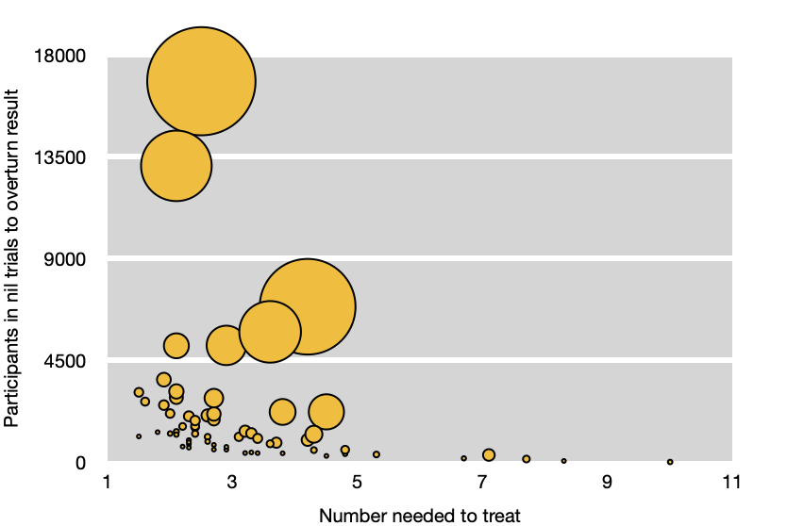
How susceptibility works
Susceptibility to publication is more likely when:
effect size is small (high NNT)
sample size is small
These data, from an acute pain overview (CD008659), demonstrates that with low (good) NNT and large sample size, publication bias is unlikely to affect a result
Size of the symbol is proportional to the number of participants in the meta-analysis

Slide 10
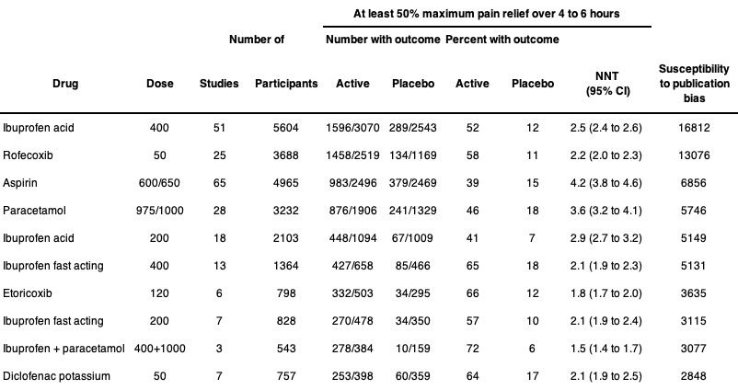
Robust data on efficacy are unlikely to be overturned by publication bias

Slide 11
Calculating susceptibility
The calculation sheet and method are given on the next side
It is simple arithmetic, and requires no complex statistical methods
It is available as an Excel spreadsheet from PaPaS, together with a PDF of the book chapter explaining how the method was derived
A worked example of ibuprofen acid 400 mg from the previous slide is shown in a subsequent side

Slide 12
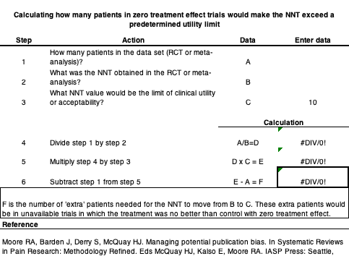
Calculation method

Slide 13
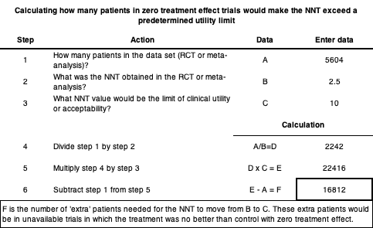
Calculation example
Example is for 400 mg ibuprofen acid in Cochrane Review, with 5604 participants in 51 trials, with NNT for at least 50% pain relief of 2.5 (2.4 to 2.6)

Slide 14
Conclusion
Considerable information on publication bias in Cochrane Handbook
Refers to negative trials not being published, or where publication is considerably delayed
Implication is that effect sizes in meta-analysis my be inflated because of publication bias
But it is all but impossible to know what the extent of publication bias is likely to be in almost all circumstances
clinicaltrials.gov and similar registries make it possible to estimate the amount of unpublished material (see CD007400.pub3)

Slide 15
Acknowledgements
Thank you to the Cochrane Network Innovation Fund
Thank you to Mohammed A. Abusayed (University Hospitals of Derby and Burton, UK) for auditing reviews of interventions for pain in the Cochrane Library in 2016
Thank you to all the project team members and MOSS key contacts
Joanne Abbott; Geert Crombez; Rob Dellavalle; Christopher Eccleston; Anna Erskine; Emma Fisher; Kerry Harding; Jennifer Hilgart; John Lawrenson; Hopin Lee; Nuala Livingstone; Lara Maxwell; Andrew Moore; Gill Norman; Neil O'Connell; Roses Parker; Phil Riley; Kate Seers; Teo Aminah Wasteneys Quay; Andrew Smith; Martin Tramèr; Peter Tugwell; Katie Webster; Amanda C de C Williams
All the slides and documents hosted on the PaPaS website https://papas.cochrane.org/resources/acute-pain-outcomes

