Slide 1




Postoperative pain
Measuring postoperative pain

Slide 2
Contents
01 | Background to measurements
02 | Categorical pain intensity and pain relief scales
03 | Visual analogue and composite pain scales
04 | Patients must measure their own pain
05 | How pain scores are expressed and calculated
06 | Time to remedication and other measures

Slide 3
Background to measurement
There are standard methods of measuring pain intensity and pain relief using:
Categorical rating scales
Visual analogue rating scales (VAS)
Numerical rating scales (NRS)
The person with pain should assess and report their pain
No other person can measure it accurately
Rules here are for people who can communicate
Does not apply to children or where communication impossible

Slide 4
Categorical verbal pain scales
Low values good
High values good
Pain intensity
severe 3
moderate 2
mild 1
none 0
Pain relief
complete 4
good 3
moderate 2
slight 1
none 0

Slide 5
Visual analogue pain scales
Pain intensity scale
LEAST possible pain
WORST possible pain
Low values good
Pain relief scale
NO relief of pain
COMPLETE relief of pain
High values good

Slide 6
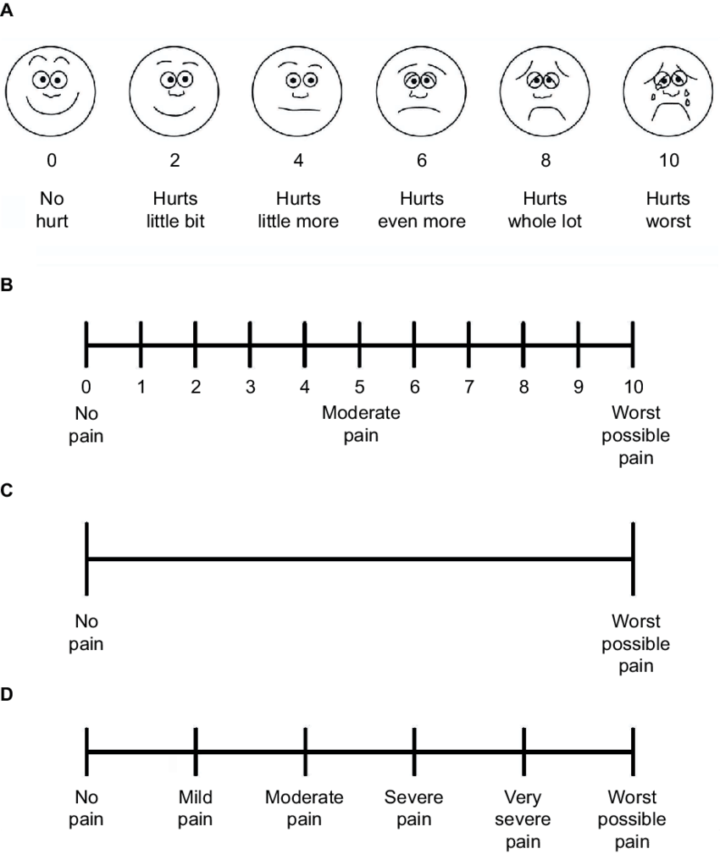
Numerical rating and other scales
A = Faces scale, usually used for children
B = NRS with 0-10 with three anchors
C = VAS without numbers and with two anchors
D = NRS with six anchors but without numbers

Slide 7
Patients must measure their own pain
Survey to determine extent of congruence in pain reporting:
Inpatient self-reported pain (n=869)
Nurse pain-evaluation (n=115)
Congruence was limited
Nurse evaluators underestimated pain more at higher pain levels
Melotti et al. Europ J Pain 2009 13:992–1000

Slide 8
Patients must measure their own pain
Systematic review comparing paired pain scoring by patient and caregiver
80 studies, with 20,496 patients
Compared with patient, caregiver estimates were reported to be:
Underestimated in 62 studies (78%)
Same 17 studies (21%)
Overestimated 1 study (1%)
Larger and high-quality studies reported underestimation in 90% of cases
The extent of underestimation tended to increase with pain severity
Magnitude of underestimation approximates the best pain treatments
Seers et al. Pain 2018 159:811-18

Slide 9
Timing of measurements
What happens without an analgesic intervention?
How long does acute pain last?
Typically hours to a few days postoperatively, but may be minutes in some circumstances
How long does the analgesic intervention last?
Usually 4 - 6 hours for oral analgesics, but some interventions may be longer
An example from third molar extraction

Slide 10
What happens with ibuprofen
Individual patient data from RCT with ibuprofen sodium 400 mg

Slide 11
What happens with placebo
Individual patient data from RCT with placebo
Moore et al. Europ J Pain 2015 19:187-92

Slide 12
How pain scores are expressed
For single dose studies it has been usual to sum pain measures over about 6 hours because that is how long most analgesics have lasted
Summed pain intensity difference (SPID): take difference in pain score between baseline and later times and add them up. Higher values are better
Total Pain Relief (TOTPAR): Add all pain relief scores together over time period. Higher values are better
Equivalent for VAS pain intensity (VASPI) and VAS pain relief (VASTOTPAR)

Slide 13
Areas under the curve
categorical verbal rating scale: pain relief
0 = none
1 = slight
2 = moderate
3 = good
4 = complete
TOTPAR
maxTOTPAR
4
3
catPR
2
1
0
0
2
4
6
Time (h)
TOTPAR
x 100 = %maxTOTPAR
maxTOTPAR

Slide 14
Combining different pain measures
Generally cannot combine pain intensity with pain relief scores: they have different directions – low is good for intensity, high is good for relief
Combining 0 - 10 and 0 - 100 scales is frequently done, using a common base of 10 or 100 (5.6 becomes 56, or vice versa, for example)
Better to use Mean Difference rather than SMD because the MD is more meaningful
Difficult to combine 0 - 10 or 0 - 100 scales with categorical scales
Evidence detail: it is known that categorical or VAS pain intensity and pain relief scales, and global rating scales, all provide the same estimate of efficacy when studies in individual patient data analyses from the same group of trials using identical methods

Slide 15
Other measurements
Other measures may be made and may be relevant depending on:
type of intervention or surgery
type of patients
single or multiple dose
duration of the study
Other measures and outcomes will be the subject of later sections

Slide 16
Acknowledgements
Thank you to the Cochrane Network Innovation Fund
Thank you to Mohammed A. Abusayed (University Hospitals of Derby and Burton, UK) for auditing reviews of interventions for pain in the Cochrane Library in 2016
Thank you to all the project team members and MOSS key contacts
Joanne Abbott; Geert Crombez; Rob Dellavalle; Christopher Eccleston; Anna Erskine; Emma Fisher; Kerry Harding; Jennifer Hilgart; John Lawrenson; Hopin Lee; Nuala Livingstone; Lara Maxwell; Andrew Moore; Gill Norman; Neil O'Connell; Roses Parker; Phil Riley; Kate Seers; Teo Aminah Wasteneys Quay; Andrew Smith; Martin Tramèr; Peter Tugwell; Katie Webster; Amanda C de C Williams
All the slides and documents hosted on the PaPaS website https://papas.cochrane.org/resources/acute-pain-outcomes

