Slide 1
GES Poster Template
Tips for effective academic poster design
This template is not mandatory, but you are highly encouraged to use it! Use this as a starting point and adapt it to meet your needs.
This poster template is based on the latest evidence.
Research recommends:
Clear conclusions/main finding at the start
Infographics or large figures
Uncluttered layout – link to additional info with a QR code
High contrast colours and large font
Tips for your poster:
Use bold to emphasize important words in your main findings and elsewhere.
The colour behind the top findings box can be changed – to a solid colour, a texture, or even a picture.
You are welcome to change the colours to match your host institution/organization.
If you’d like to use a picture on your poster, we recommend choosing light and bright imagery that works in harmony with your poster’s colour palette. See Cochrane’s image check-list for more help.

Slide 2
QR Codes
To create a QR code, we recommend the free QR code maker at QR Code Monkey.
Want to link your QR code to multiple things like your paper, a copy of your poster and your contact details? Try hosting the links all in one spot and link to that; it could be a social media post that you link to or a free online tool like Linktree.
Tips for poster accessibly
Have your QR code link to an online audio and/or video walkthrough of your poster
Have a few handouts for people who can’t scan a QR code
Consider using a colourblind checker to ensure your poster is accessible to viewers with different types of colourblindness.
Additional Resources
Video on creating a #BetterPoster in less time
Book on planning, designing and presenting an academic poster

Slide 3
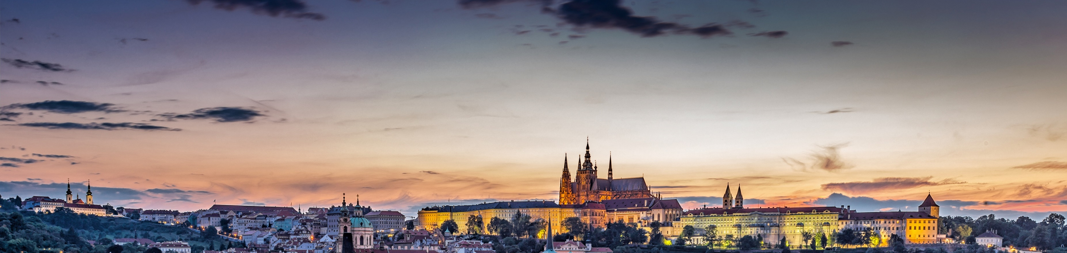
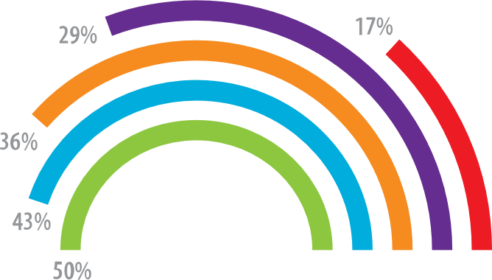

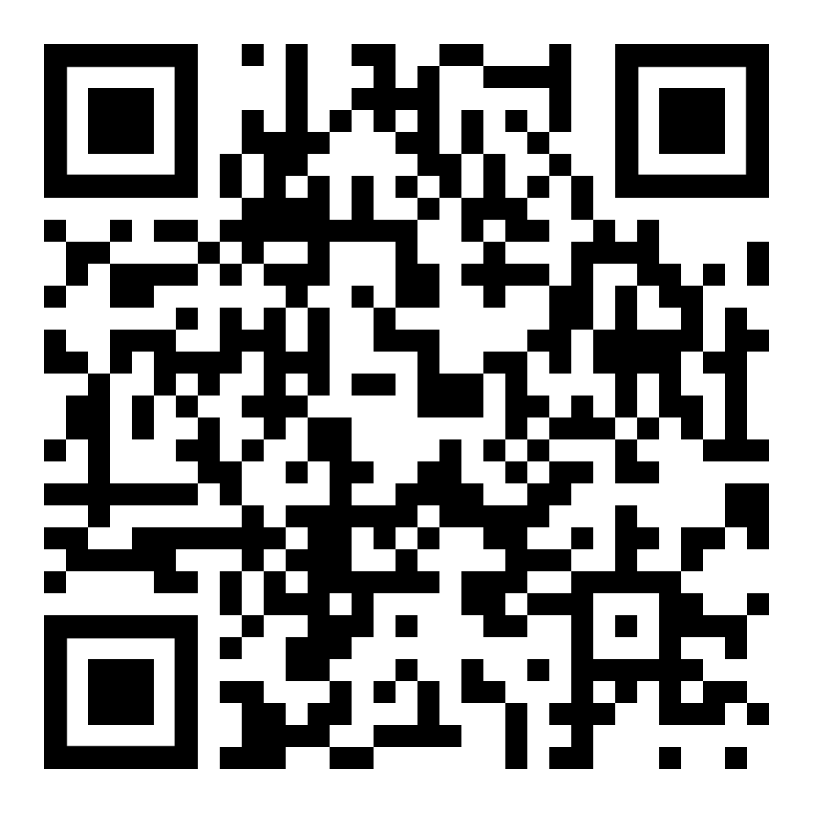

Teach people what you
learned in 5 seconds
Title goes here: Investigating the dynamics of X on Y.
Background: 70,000 people needed a portrait-orientation style layout for #betterposter, according to the Open Science Framework download counts.
Result 1: Quickly explain what the graph shows. Help people think.
Result 2: You can add bullets or quotes to this section too.
v
v
“Here is a quote that illustrates a main finding. You can use bold to highlight main points if you like”
- Survey Respondent
Methods
Survey
Longitudinal
v
You can list out the main steps and points here
You can list out the main steps and points here
You can list out the main steps and points here
You can list out the main steps and points here
You can list out the main steps and points here
You can list out the main steps and points here
You can list out the main steps and points here
You can list out the main steps and points here
You can add graphics, pictures, or more text
.
Limitation: This is only one interpretation of findings that suggest effective posters are uncluttered, have big figures & text, and include callout boxes with takeaways. It is missing your personality and creative flair.
Organization or Group Name
Leeroy Jenkins, Shuri Wright, Emmett Brown
If a published paper, you can include the citation here.

Slide 4
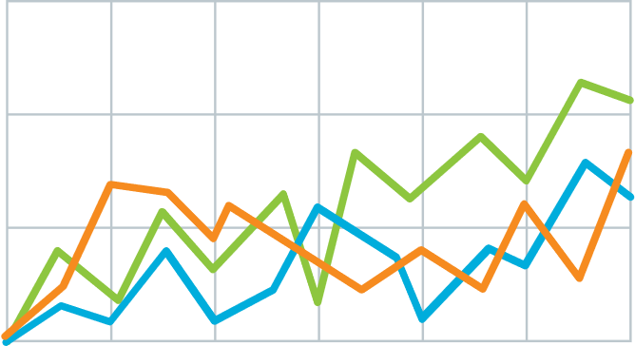
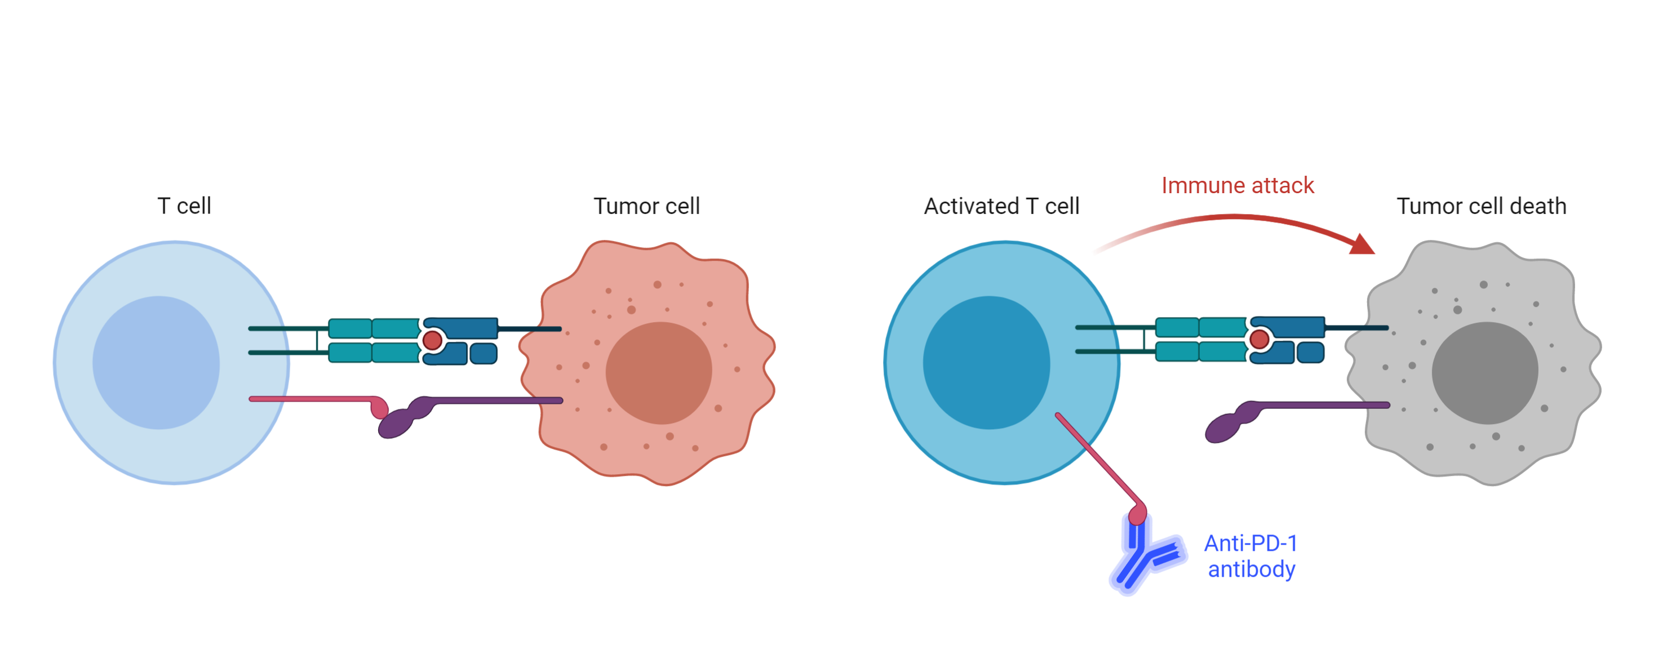

Teach people what you learned in 5 seconds (takeaway, not title)
Title goes here: Investigating the dynamics of X on Y.
Background: 70,000 people needed a portrait-orientation style layout for #betterposter, according to the Open Science Framework download counts.
Result 1: Quickly explain what the graph shows. Help people think.
Result 2: Big figures are easier to skim at a distance, and more accessible.
v
v
Methods
Survey
Longitudinal
v
1
Immune checkpoint inhibits T-cell activation.
2
Anti-PDF-1 antibodies permit T cell activation
Limitation: This is only one interpretation of findings that suggest effective posters are uncluttered, have big figures & text, and include callout boxes with takeaways. It is missing your personality and creative flair.
Leeroy Jenkins, Shuri Wright, Emmett Brown

Slide 5







Main point here
Tips for effective academic poster design
Intriguing Topic
Descriptive Chart Title
A well-designed poster captures attention, facilitates comprehension, and engages viewers, making complex information accessible through organized content, concise text, and visually appealing graphics.
Therapists
Pharmacists
Sub-heading
A well-designed poster captures attention, facilitates comprehension, and engages viewers, making complex information accessible
Doctors
Nurses
Sub-heading
A well-designed poster captures attention, facilitates comprehension, and engages viewers, making complex information accessible
Physiotherapists
How To Learn More:
address@email.com
60%
yourwebsite.com
Of people do this
+44 (0) 123-1234
Citation of paper or additional information
Leeroy Jenkins, Shuri Wright, Emmett Brown

Slide 6
Printing
Posters should be printed on A0 size
84.1cm (w) x 118.9cm (h)
33.11 inches (w) x 46.81 inches (h)

