Slide 1
Getting all clinical trial results reported
Till Bruckner
www.TranspariMED.org
tillbruckner@gmail.com
Lund, 16 June 2021
Lessons learnt from successful universities
Published under a Creative Commons license.
Anyone may share or re-use parts or all of this presentation without seeking permission. CC-BY 3.0.

Slide 2
Do we have a problem
2018 IntoValue study (QUEST)
27% of trials run by German universities never published their results anywhere
---> not on registries + not in journals
Total of 433 trials involving >50,000 patients

Slide 3
Reporting rules
-> All interventional trials pre-reg
-> Registry data kept up to date
-> All results on registry in 12 months

Slide 4
Top ten academic institutions
All now reporting results
Most have reported 100%
7 universities already reporting
1 will start soon
2 still unclear

Slide 5
How to fix it
STEP 1: Central oversight over trial registries
TOP LESSON LEARNT:
Preventing problems is much easier than fixing them later
Old trial result with messy data onto EudraCT = 3 days
Good systems and processes = 2-3 hours per trial
STEP 2: Audit existing registry entries
STEP 3: New policies and processes
STEP 4: Support researchers
STEP 5: Monitor registry entries (ongoing)

Slide 6
Getting the resources you need
Legal risk (US now; EU from February 2022)
Financial risk (US: $11,000 per day; Denmark)
Funding risk (Wellcome, Gates, national)
Reputational and political risk
Scientific excellence (WHO)
“Do our patients matter… or not?”

Slide 7
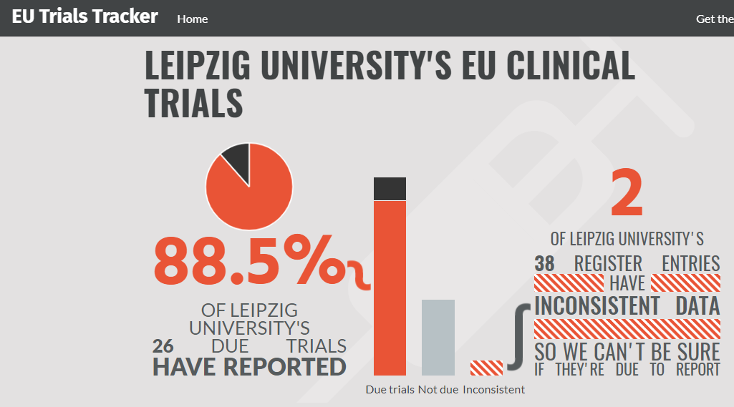
Getting the help you need

Slide 8
You are not alone
www.TranspariMED.org
tillbruckner@gmail.com

