Slide 1
Centralizing the Clinical Trial Registration and Results Reporting Process in Academic Institutions
Tony Durkee, PhD
Coordinator for Clinical Trial Reporting
Compliance & Data Office (CDO), Research Support Office (RSO)
Karolinska Institutet (KI)
Email: tony.durkee@ki.se

Slide 2
Clinical Trial Transparency at European Universities
Mapping unreported drug trials
(Source: Transparimed. Report, 2019)

Slide 3

Reporting performance by country
(Source: Transparimed. Report, 2019)

Slide 4
Clinical Trial Transparency in Sweden Mapping unreported drug trials
Over 70% of verifiably due clinical trial results are missing.
Five Swedish sponsors with verifiably due results have not made a single trial result public in the registry.
The 22 sponsors covered by this report have failed to report the results of an estimated 277 drug trials.
The Swedish (nominal) reporting rate of 30% is far below the average reporting rate across all European drug trials.
(Source: Lund University, Cochrane Sweden and Transparimed. Report, 2020)

Slide 5
(Source: Lund University, Cochrane Sweden and Transparimed. Report, 2020)

Slide 6
Result of the Clinical Trial Transparency
Reports and Media Attention
The University Director at Karolinska Institutet (KI) issued a directive to establish a new initiative to centralize the registration and results reporting for clinical trials at KI.
The directive was issued to the Compliance & Data Office (CDO) unit within the Research Support Office (RSO).
CDO assigned a lead coordinator and task force with the primary objective to develop guidelines and procedures for centralizing, monitoring and improving clinical trial registration and results reporting at KI.

Slide 8

Initial assessment for centralization in academic institutions
Assessment of institution’s clinical trials
  Systematic search in EudraCT, WHO ICTRP Portal
  Identify and search internal institution databases
Assessment of available resources
  Manager or lead coordinator
  Personnel
  Training

Slide 9
Develop a model for centralization according to institutional needs
Decentralised model: researchers retain full control over the registry entries for their own trials. The registry manager oversees the portfolio as a whole, sends emails to remind researchers to update entries or upload results, and provides training and support on demand, for example by sitting with researchers when they enter data into registries.
Centralised model: the registry manager assumes full and exclusive control over all trials in the institution’s portfolio. When updates or results are due, the registry manager requests the necessary data from researchers, and then directly enters that data into registries.
Cluster model: The registry manager has oversight of the overall portfolio. Each research cluster (or unit) within the institution has one designated point person who assumes control over all trials run by that cluster, and directly enters data for that cluster’s trials into registries.
A la carte model: researchers are given a choice between directly managing registry data for their own trials, or letting the registry manager perform that task for them.
(Source: T. Bruckner, Quest: Report, 2020)

Slide 10

Model advantages and disadvantages
(Source: T. Bruckner, Quest: Report, 2020)

Slide 11
Strategies for centralization in academic institutions
Develop a database or institutional portfolio of clinical trials the institution is responsible for as the sponsor.
Identify unreported trials and common problems.
Develop a work-plan that includes specific objectives, milestones, goals and expectations.
Register for PRS Administrator account in clinicaltrials.gov and an institutional account including ‘results user’ for EudraCT.
Develop institutional guidelines and/or procedures manual.

Slide 12
Strategies for centralization in academic institutions
Develop an institutional website for clinical trial registration and reporting.
Promote the centralization of registration and reporting using available media outlets.
Contact and develop relationships with researchers.
Develop collaborations with local, national and international entities.
Develop collaboration with National Competent Authority.

Slide 13
RESULTS
Centralization of clinical trial registration and reporting at Karolinska Institutet (KI)
We have assigned a lead coordinator and task force.
We developed a model for centralization.
We have developed a work-plan.
We have developed guidelines/procedures manual.
We developed an institutional trial portfolio.
We have a registered PRS Administrator account for clinicaltrials.gov.
We have an institutional account for EudraCT.
We developed national and international networks and collaboration.
We have contacted over 150 researchers.

Slide 15
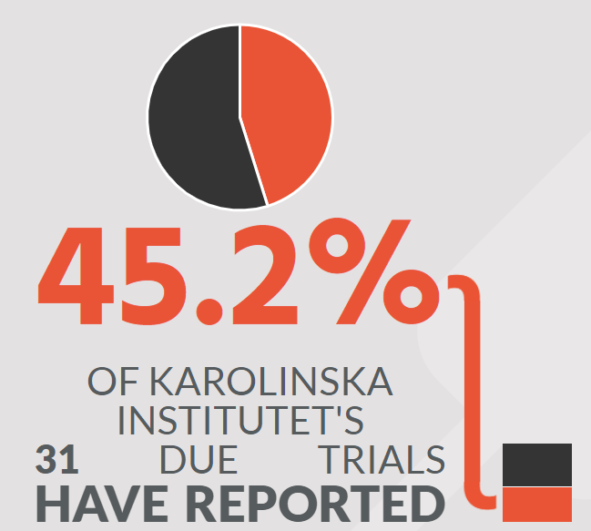
RESULTS
Centralization of clinical trial registration and reporting at Karolinska Institutet (KI)
We have updated and reported results for nearly 300 clinical studies in clinicaltrials.gov.
We have reported results in EudraCT and increased to a 45.2% compliance rate for results reporting.

Slide 16



